Slide 1

Predicting trip duration from ride-hailing data in Chicago, US
Team 4 Louis, Malak, Lena and Eero

Slide 2
Business Understanding
Background
Prediction Task
Relevance

Slide 3
Business Understanding
Background
Prediction Task
Relevancy
City of Chicago
Ride-hailing industry
Trip duration estimation
Enhancing real time predictions
Stakeholder Analysis

Slide 4
Stakeholder Analysis
Primary Stakeholders
Operations Team
Customer Service
Product Management
Data Science Team
Secondary Stakeholders
Drivers
Passengers
Business Leadership
External Stakeholders
Ride-Hailing Providers
Reulators and City Planners

Slide 5
Data Understanding
Data Source Overview
Data Acquisition & Loading

Slide 6

Data Source Overview
City of Chicago Open Data Portal
2023-2024
174M rows of data
24 individual features
Data collected via routine reporting by ride-hailing companies

Slide 7

Data Acquistion & Loading
Filter application
Reducing data to every 100th row
327,526 individual trips for further processing
~55 trips per unique pickup/dropoff area code combination

Slide 8
Data Limitations & Modeling Considerations
Deficient Data Quality
Data Representation Challenges
Modeling Considerations

Slide 9
Data Preparation
Data Exploration*
Data Cleaning
Feature Engineering
Feature Selection
Post-Prep EDA & Visualizations

Slide 10
Data Exploration
Visual and Statistical Summaries:
Data Quality Assessment
Missing values, data types, duplicates, outliers etc.
Exploratory Analysis & Visualization
Feature distributions, relationships, visual patterns etc.
EDA starting with: Target Variable Analysis
Next Slide

Slide 11
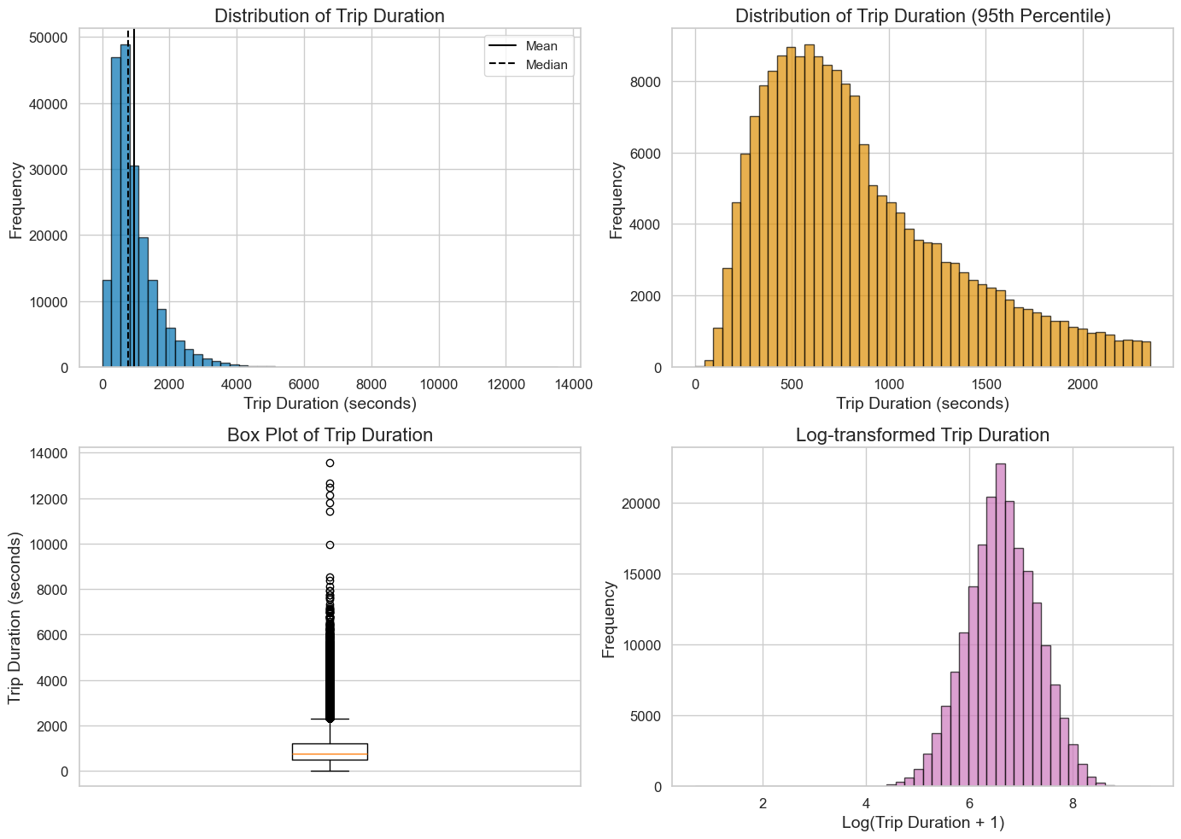
Various graphs regarding trip duration
Mean: 16 minutes
Median: 12.6 minutes
Distribution heavily right-skewed
Most trips between 4-16 minutes

Slide 12
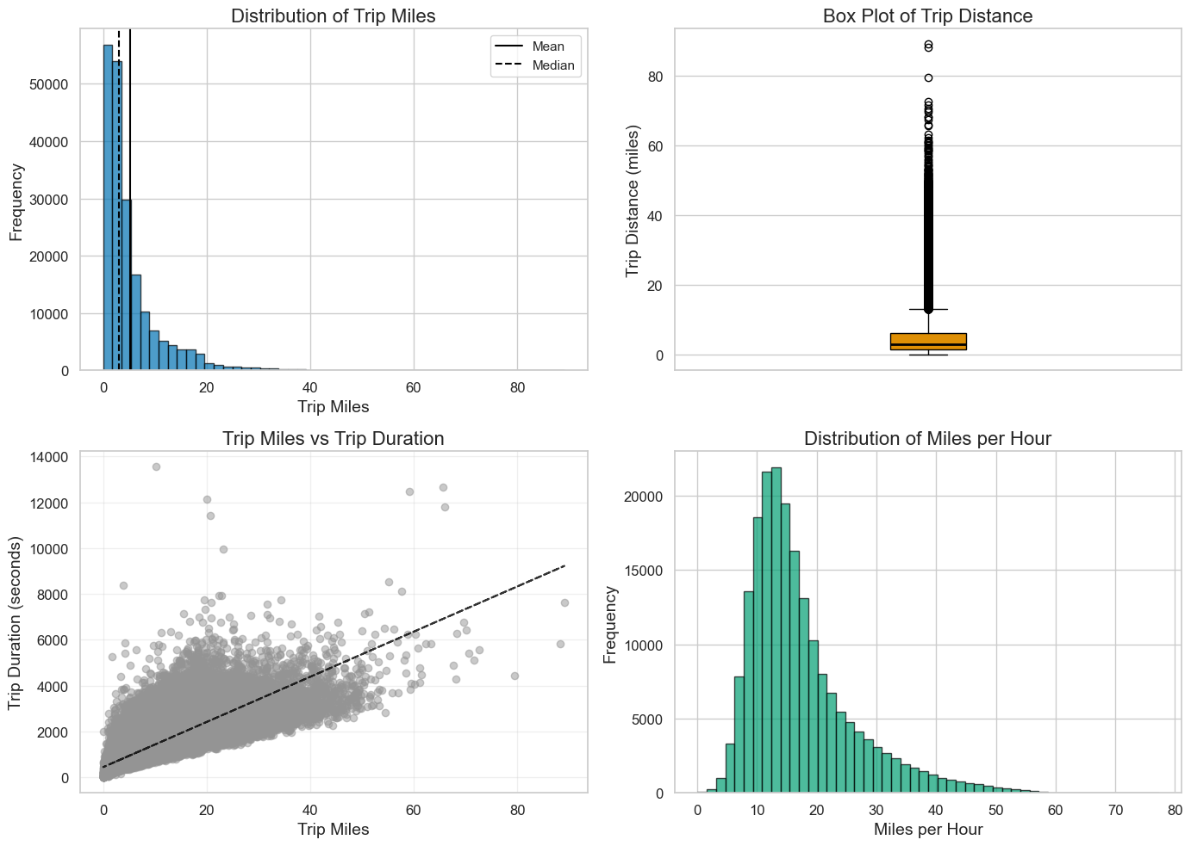
Trip distance vs. Trip duration analysis
Positive correlation with high variability
Frequent delays relative to distance
Speed distribution reflects urban conditions
Distribution consistency confirms data quality

Slide 13
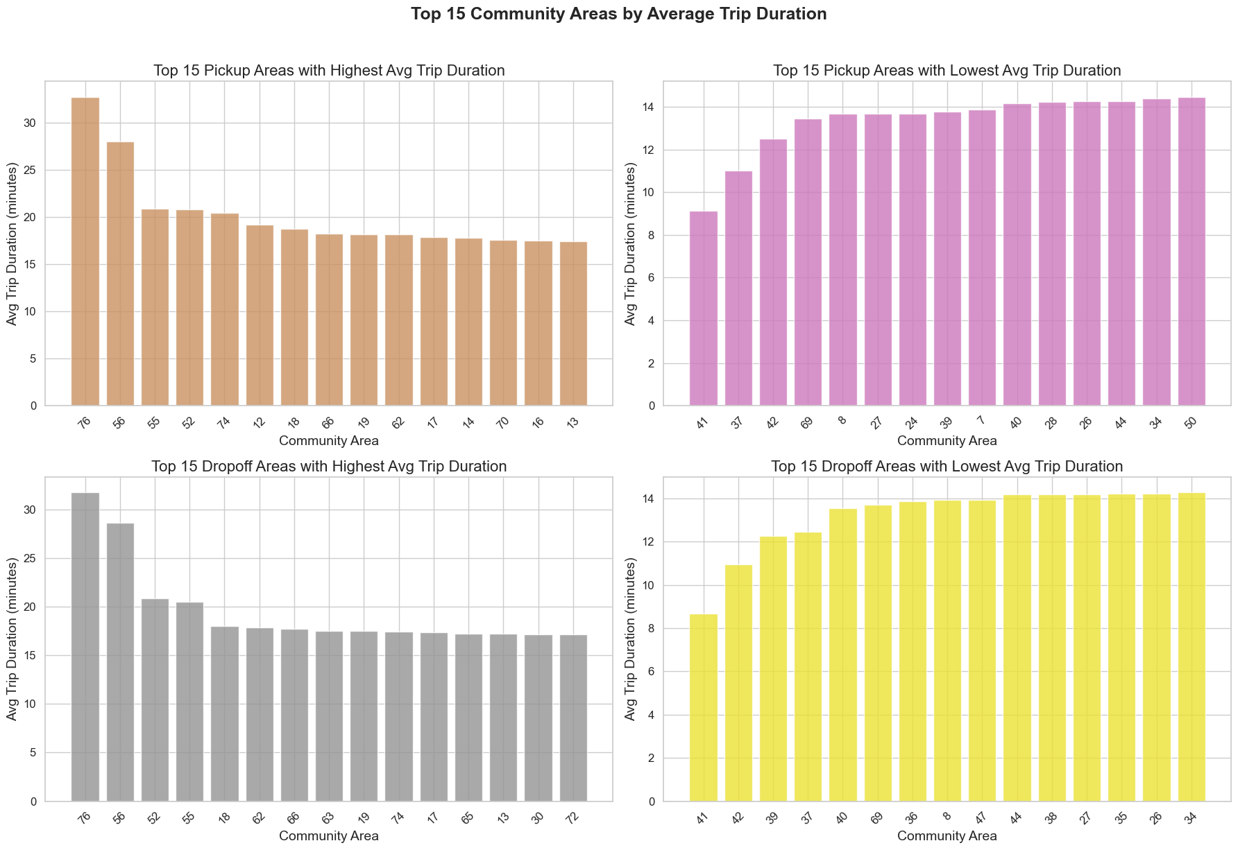
Strategic takeaways for stakeholders via spatial analysis
Commuter Zones (12&18)
Peripheral Areas (76&56)
Short-Trip Neighborhoods (41,37,42)
Service Planning

Slide 14
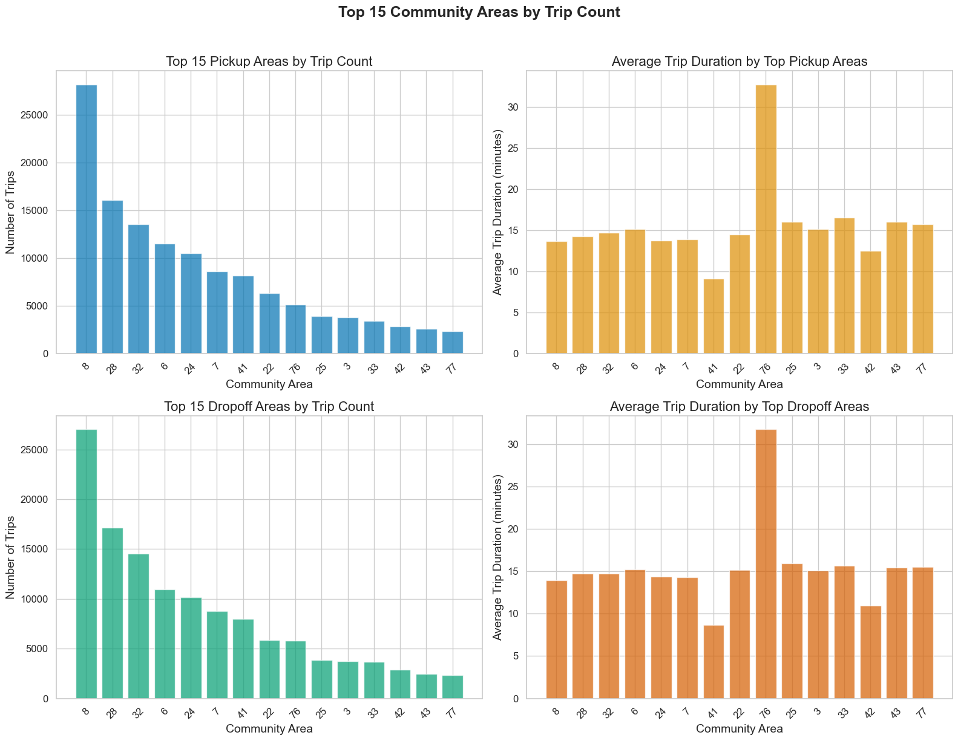
Insights from Top 15 community areas by trip count
Busy areas (8,28,32)
Range of trip duration
Statistical anomalies (41&76)

Slide 15
Stakeholder Reflections
Are long trips from peripheral areas a result of poor infrastructure, or natural commuting patterns?
Should we target service improvements (e.g., transit or rideshare coverage) in areas with longer average trip durations?
Can we optimize dispatch or resource allocation based on highly local vs. outbound trip behaviors?
What socioeconomic or geographical features explain why some areas generate shorter vs. longer trips?

Slide 16
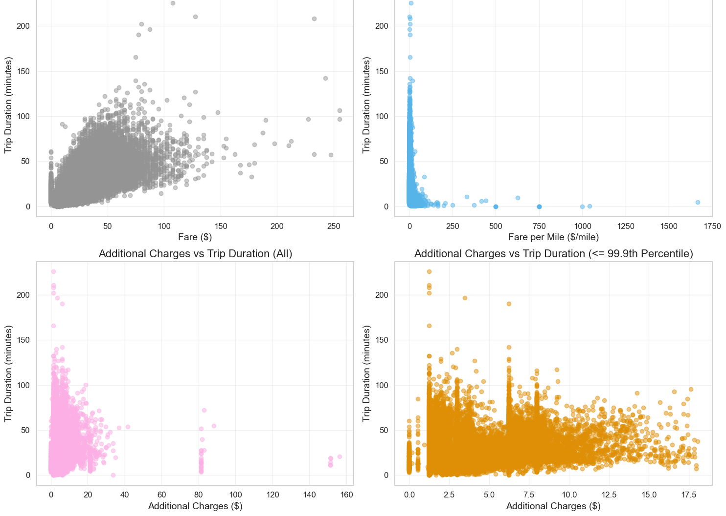
Financial Analysis
Strong positive correlation between trip duration and fare
Efficiency gains per-mile
Charge Clustering
Independent additional charges

Slide 17
Possible Business Implications for Stakeholders
Pricing Strategy
Distance-based efficiency
Short trip premium
Surge pricing impact
Operational Insights
Trip duration sweet spot
Pricing transparency
Market segmentation
Data Quality Observations
Outlier Management
Missing values
Skewed distribution

Slide 18
Data Cleaning
Ensuring Format Consistency
Duplicates Removal
Handling missing values
Outlier handling
Simple Exploration of „Non-Sensical“ Records
Stastical Detection with Domain Context
IQR Method

Slide 19
Feature Engineering
Temporal Feature Extraction
Merging Weather Data
Cleaning up Weather Data
Removal of Irrelevant Features
Based on previous descisions
Weather conditions like temperature, rainfall, wind etc.
Extracting from trip_start_timestamp via Pandas
Prior final feature selection
Feature Encoding
Feature Scaling
For categorial (coordinate) variables
Standardize numeric features using StandardScaler

Slide 20
Final Feature Selection
Why do we need to pick features ?
Noisy features, redundant features, overfitting, computational cost
How do ”we” pick features ?
Varience Criterion
Correlation Criterion
Statistical Feature Selection
Embedded Methods – Lasso Feature Selection

Slide 21
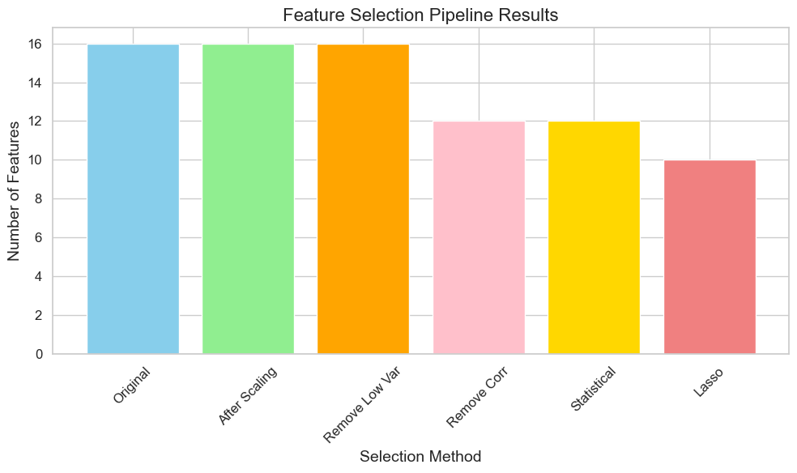
Final Feature Selection - Coding Results
Trip_miles
Fare
Additional_charges
Hour
Is_peak_hour
Month
Temp_pickup
Prcp_pickup
Wsdp_pickup
Dropoff_community_area_target_encoded
Trip_seconds

Slide 22
Post-Prep EDA & Visualizations
Weather data correlation
Temporal factors

Slide 23
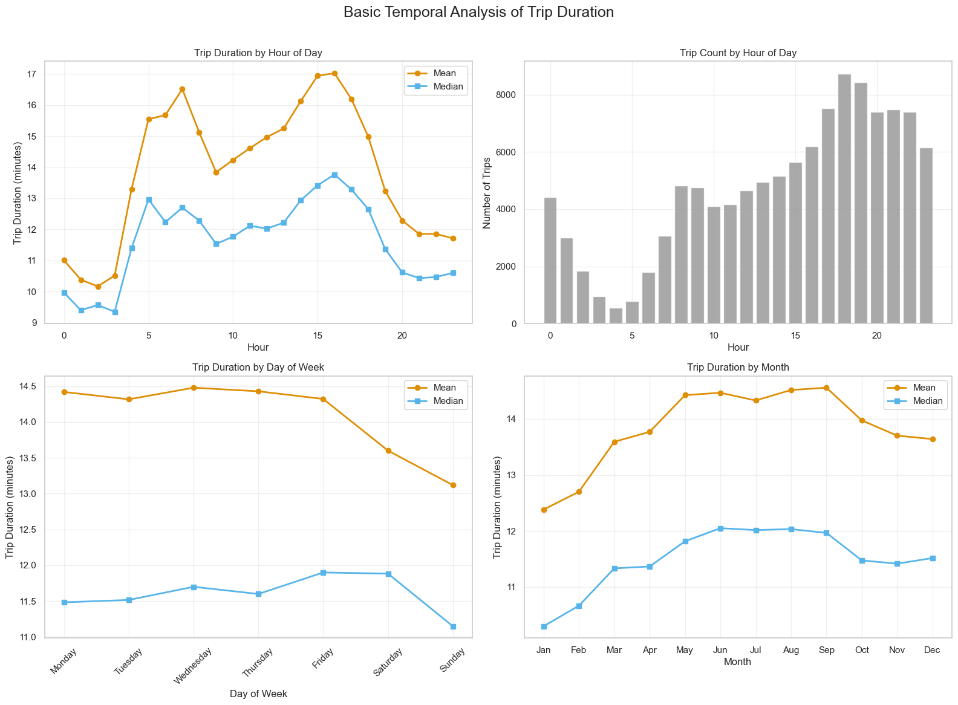
Basic Temporal Analysis of Trip duration
Peak hour congestion (4pm&7am)
Increasing demand over the day
Weekday vs. weekend patterns
Seasonal Variation

Slide 24
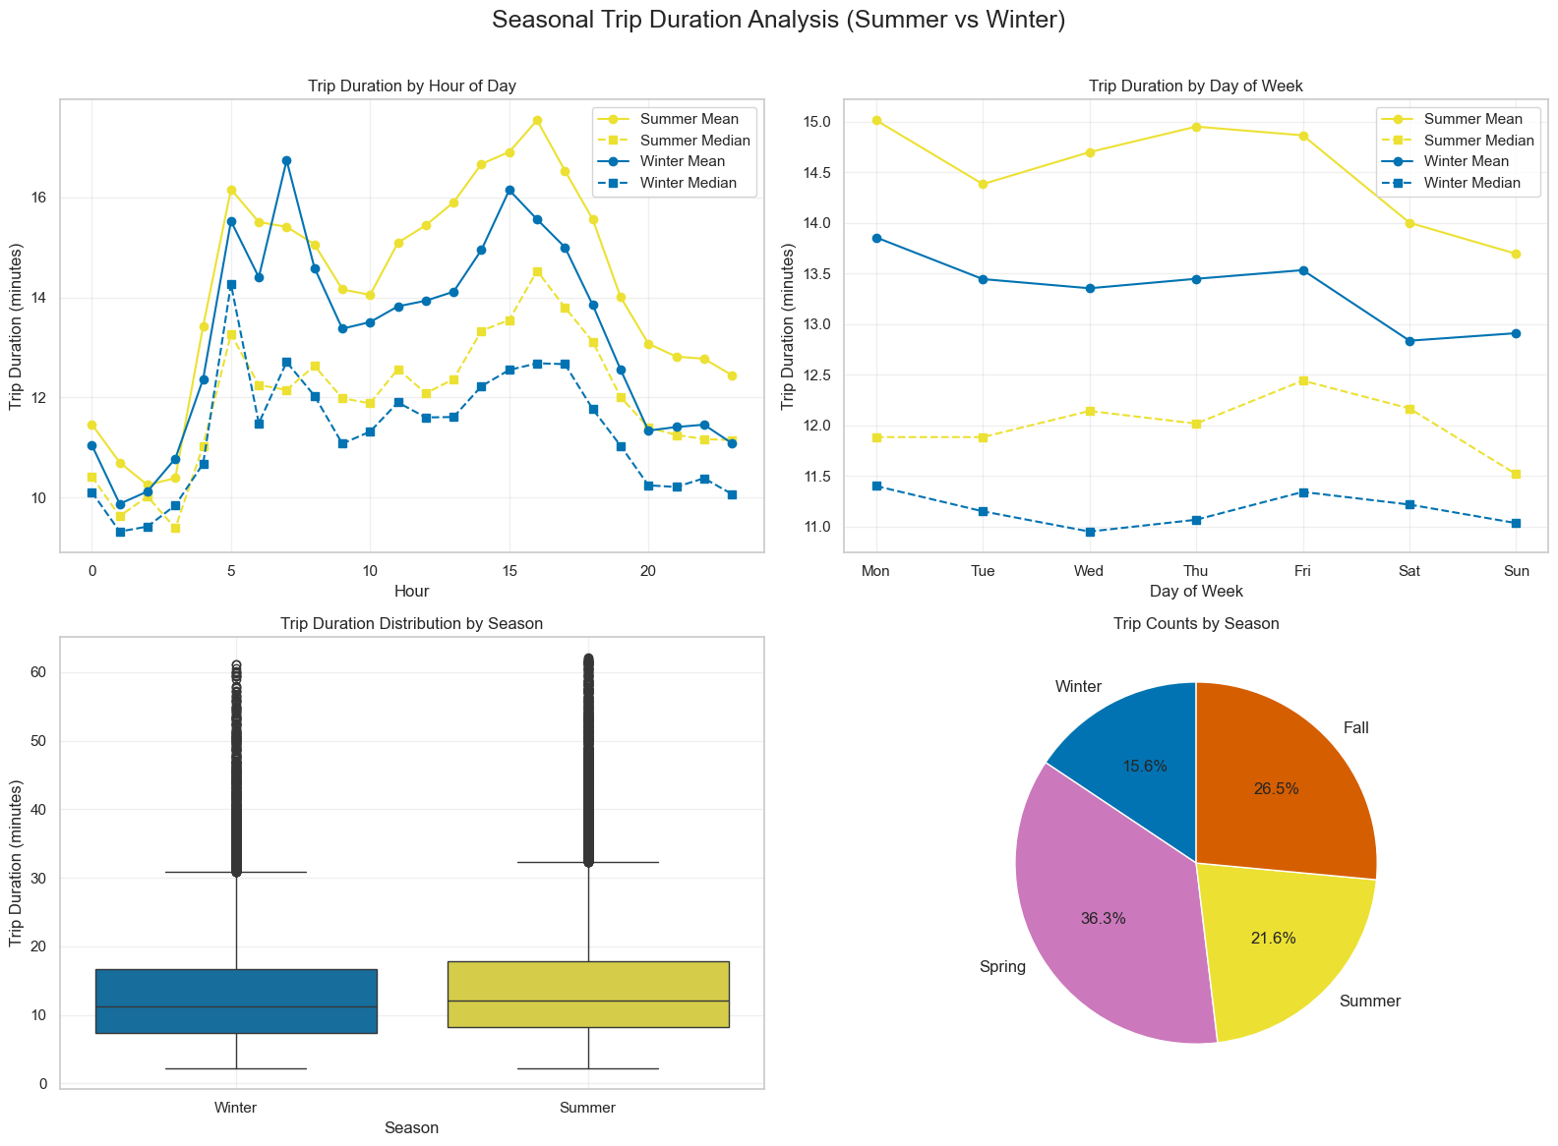
Seasonal Insights
Higher demand and longer trips during summer
Stronger peak hours during summer
Seasonal marketing and off-season opportunities

Slide 25
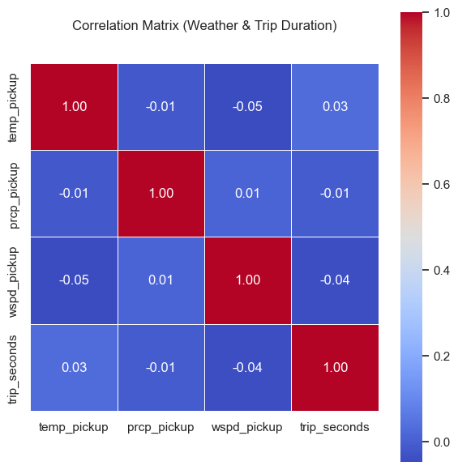
Correlation Insights: Weather vs. Trip duration
Weather variables show very weak linear relationships with trip duration

Slide 26
Modeling
The Machine Learning Framework
Hypothesis function
Loss function
Optimization method
Model Selection
Linear Regression
Random Forest Regression

Slide 27
Evaluation Strategy
Data Splitting
Training Set (60%)
Validation Set (20%)
Test Set (20%)
Complementary regression metrics
RMSE
MAE
R^2 Score

Slide 28
Multiple Polynomial Linear Regression
Baseline model
Objective
Enhance capabilities through polynomial features and ridge regularization
Results
R^2 score of 0.6546
RMSE of 328.301 seconds
Identifies non-linear Relationships between certain features and target while remaining linear in its parameters
Hyperparameter Tuning with GridSearchCV
Implementation Considerations
Streamlining with Pipeline

Slide 29
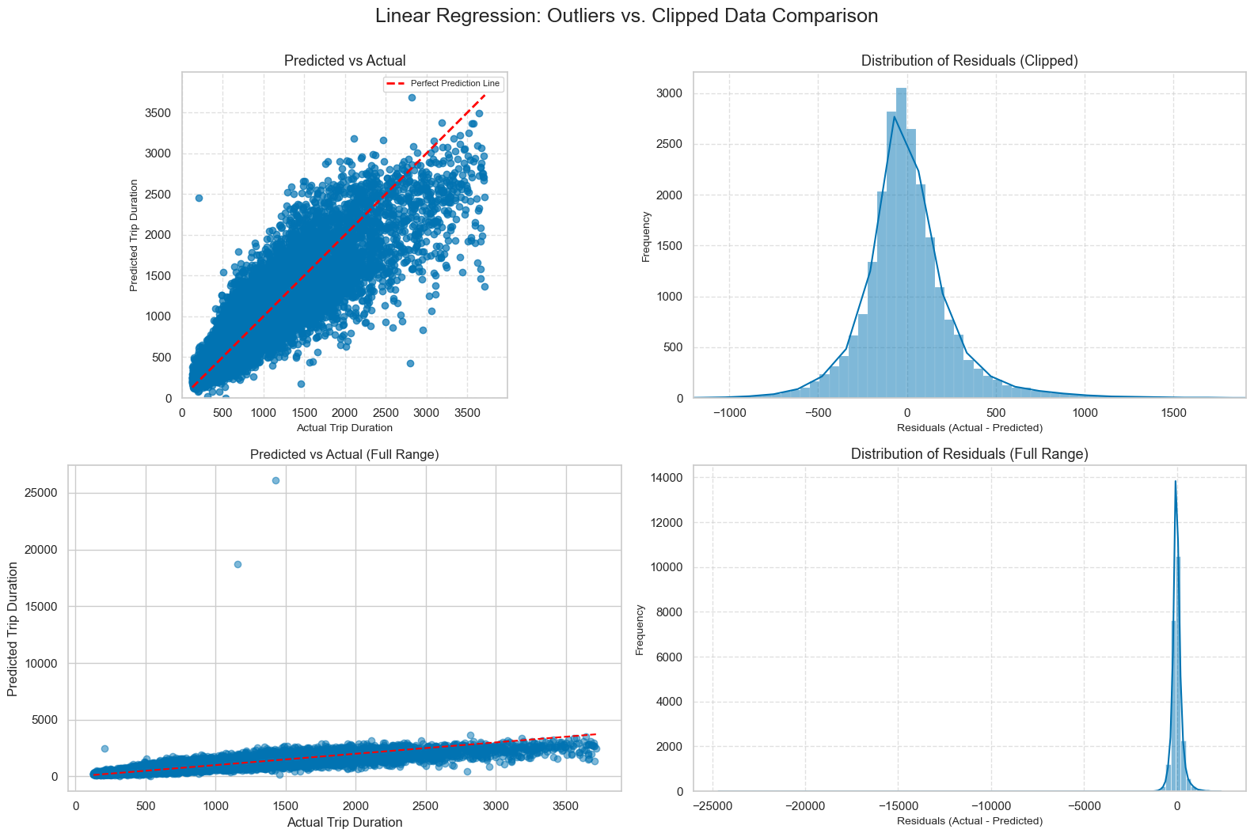
Multiple Polynomial Linear Regression

Slide 30
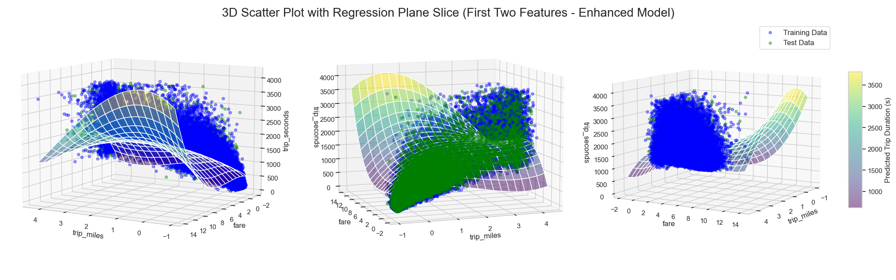
Multiple Polynomial Linear Regression

Slide 31
Random Forest Regressor
Key Concepts
Bagging (Bootstrap aggregation)
Feature Randomness
Prediction aggregation
Benefits to our Prediction Task
Complex feature interactions in urban mobility
Ability to handle mixed data
Limitations
Interpretability
Performance on small datasets
Robustness to Outliers
Results
RMSE of 246.283 seconds
R^2 score of 0.8056

Slide 32
Hyperparameter Tuning with RandomizedSearchCV
Wide range of hyperparameter values
Faster than GridSearchCV
Tests fixed number of random combinations
Very good approximation of the best model
Reduces training time

Slide 33
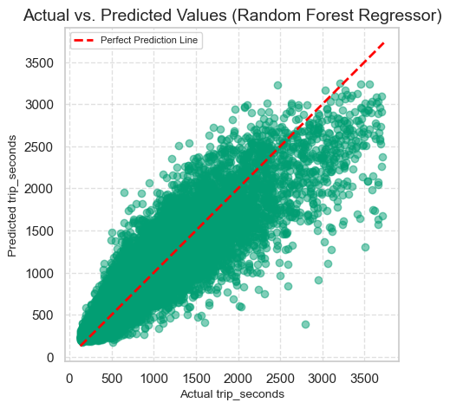
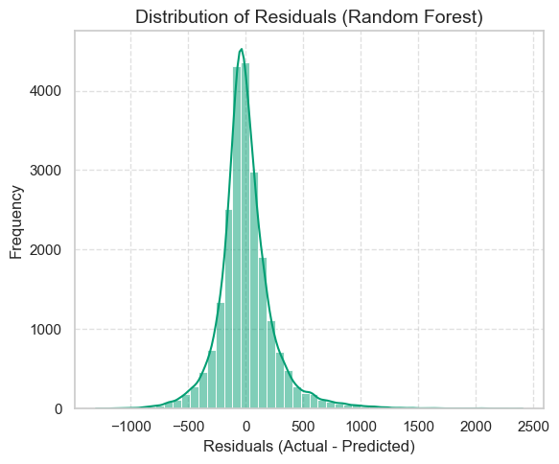
Random Forest Regressor

Slide 34

Evaluation of Trip Duration Prediction Models

Slide 35
Model Performance Comparison
Random Forest Regressor Outperforms Linear Regression
Random Forest: Lower errors (RMSE, MAE) & better fit (Higher R²)
Visually, Random Forest shows tighter predictions & better residual distribution.
Model | RMSE (min) | MAE (min) | R^2
Linear Regression | 5.47 | 3.51 | 0.65
Random Forest | 4.10 | 2.76 | 0.81

Slide 36
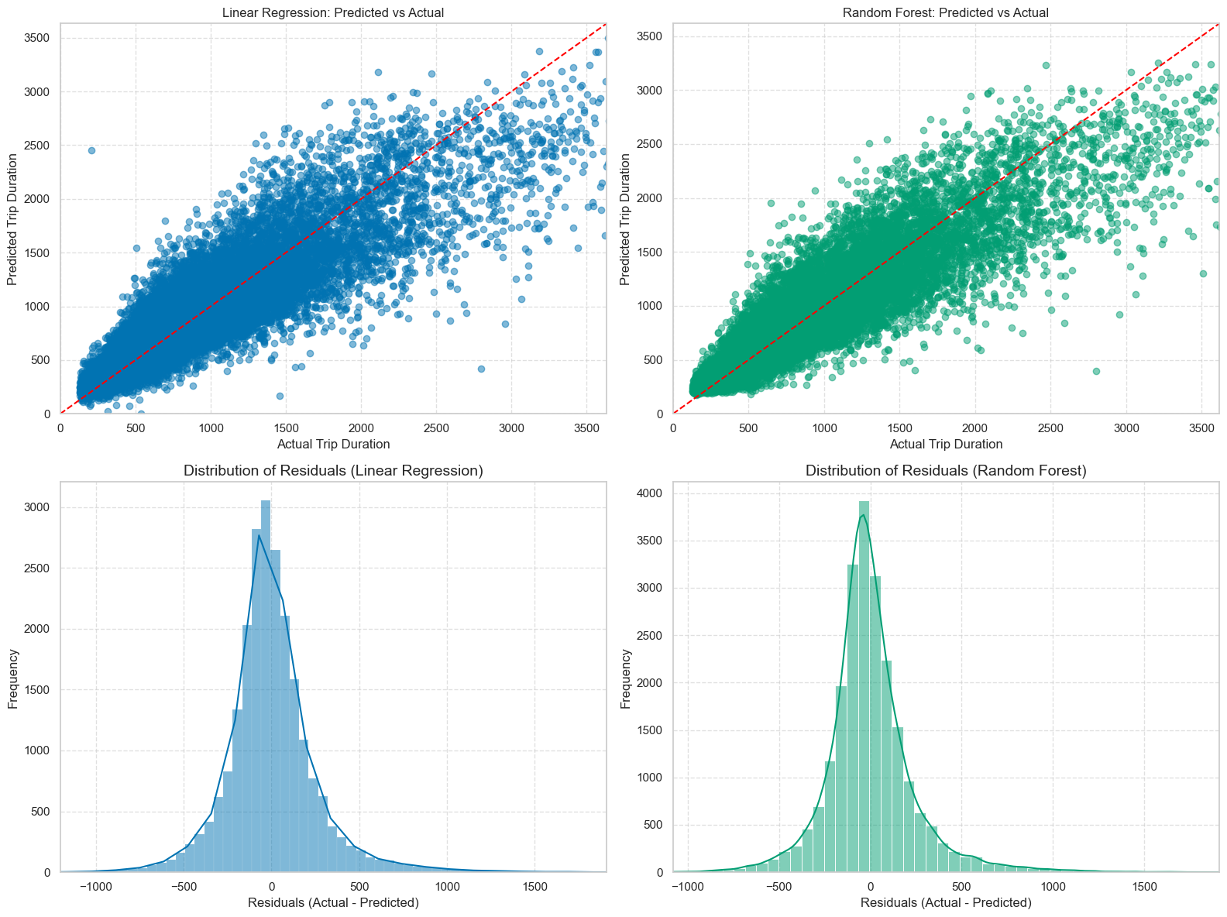
Visual Comparison of Predictions
Actual vs. Predicted Scatter Plots & Residuals
The performance is also visually evident

Slide 37
Feature Importance - Key Differences
Understanding Feature Influence
Linear Regression: Coefficients for transformed & scaled polynomial features.
Interpretation is complex; shows influence of combined/curved relationships.
Random Forest: Importance for original input features (e.g., Gini importance).
Clear, direct, and intuitive measure of impact.

Slide 38
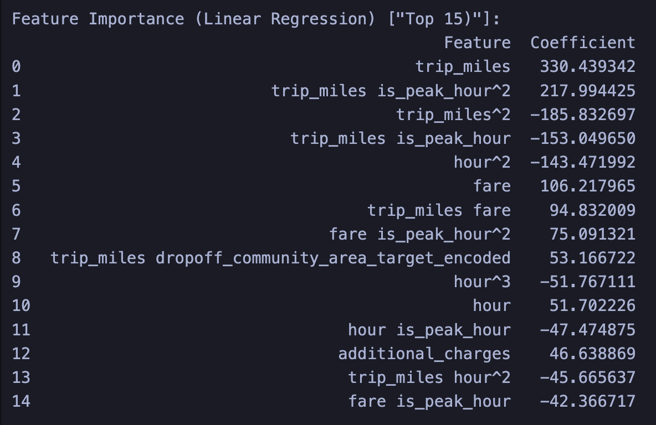

Slide 39
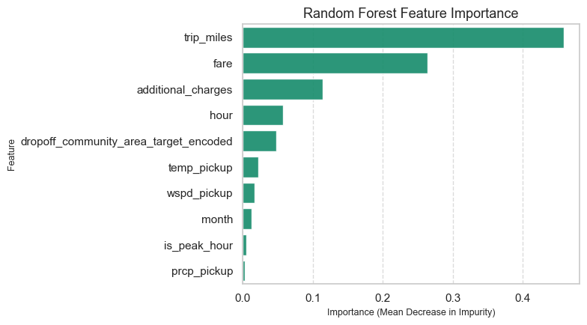
Feature Importance - Top Drivers
Both Models Highlight trip_miles and fare
Random Forest: trip_miles and fare are overwhelmingly most important (72% combined).
additional_charges and hour also significant.

Slide 40
Model Selection 1
Multiple Polynomial Linear Regression
Pros:
non-linear relationships through feature engineering.
faster prediction
informative coefficients
Cons
Assumes a functional form for non-linearity
Sensitive to outliers
Interpretation of coefficients
Less robust
Lower performance than Random Forest

Slide 41
Model Selection 2
Random Forest Regressor
Pros:
Captures non-linear and complex feature relationships.
Handling of a mix of numerical and categorical features
Robust to outliers and noisy data
Interpretable feature importance scores for original features.
Generalization performance
Superior performance metrics
Cons:
Black box model
Training is computationally more intensive
Hyperparameter tuning

Slide 42
Final Selection = Random Forest
significantly better performance metrics
better generalization to unseen data
ability to handle non-linearity
Robustness to outliers
Black box
No informative coefficients
Slower prediction

Slide 43
Business Perspective
Value for Stakeholders
01
Accurate trip_seconds prediction offers substantial value across the ride-hailing ecosystem.
A comprehensive perspective, accounting for all stakeholders, is vital for business professionals.
Domain knowledge is indispensable for feature identification, result interpretation, and real-world implications.
02

Slide 44
Business Perspective
Company (Operations & Strategy):
Optimizes resource allocation, dynamic pricing, … , strategic growth.
Drivers:
Clearer expectations for time and income management.
Potential increase in earning.
Passengers (Customers):
Delivers improved ETA accuracy and a better overall experience.
Investors/Shareholders:
Demonstrates a strong, data-driven business model and competitive advantage

Slide 45

Reflections & Potential Improvements

Slide 46
Reflections & Potential Improvements
Key Learnings: CRISP-DM's value, outlier impact, crucial data prep, ensemble model power, and the performance vs. interpretability trade-off.
Improvements:
Refine workflow planning.
More advanced feature engineering (temporal, geospatial, interactions).
Deeper dive into encoding and scaling strategies.
Advanced outlier handling.
Explore other (ensemble) models (e.g., Gradient Boosting).
Detailed error analysis for targeted enhancements.

